Slide 1



Bureau of Narcotics & Dangerous Drugs Control
Oklahoma

Slide 2

Introduction
Legalized in June 2018
HIDTA created a report

Slide 3
Medical Marijuana Industry
Oklahoma has 12 times as many licensed medical marijuana growers as Colorado, and over 3 times as many medical and recreational growers combined.
Oklahoma has more than 5 times as many licensed medical marijuana dispensaries as Colorado, and nearly twice as many medical and recreational dispensaries combined
The medical marijuana industry has produced more than 32 times the marijuana supply necessary to meet licensed patient demands.

Slide 4
Despite this drastic reduction in the number of Growers, Oklahoma has 12 Times as many licensed medical marijuana growers as Colorado*.
*Colorado has 5.8 Million residents, and Oklahoma has 4.0 Million residents.
SOURCE: Oklahoma Medical Marijuana Authority (OMMA), Licensing and Tax Data; Oklahoma; Colorado Department of Revenue, Marijuana Enforcement Division (MED) Licensed Facilities, Accessed November 19, 2024

Slide 5
The Oklahoma Medical Marijuana Authority (OMMA) commissioned a study in June of 2023 entitled “An Empirical Assessment of Oklahoma’s Medical Marijuana Market.”
The study concluded that Oklahoma’s marijuana industry produced more than 32 times the supply of marijuana than necessary to meet the need of licensed patients.

Slide 6
Youth Marijuana Use
The fifteen states with the lowest rate of current marijuana youth use all have some of the most restrictive marijuana laws in the country.
The fifteen states with the highest rate of current marijuana youth use all have full marijuana legalization to include recreational use, aside from Oklahoma and Hawaii which are only legalized medically.
Prior to legalization, Oklahoma ranked 43rd in the nation for youth marijuana use.

Slide 7
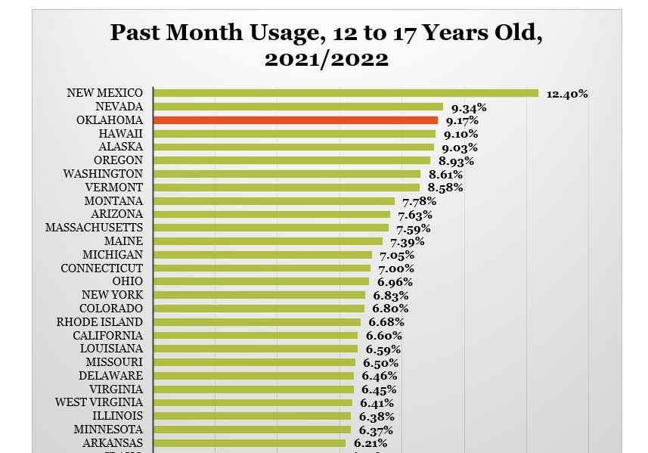
Post legalization, Oklahoma now ranks 3rd

Slide 8
Oklahoma’s youth marijuana use increased while there was a nationwide decrease.

Slide 9
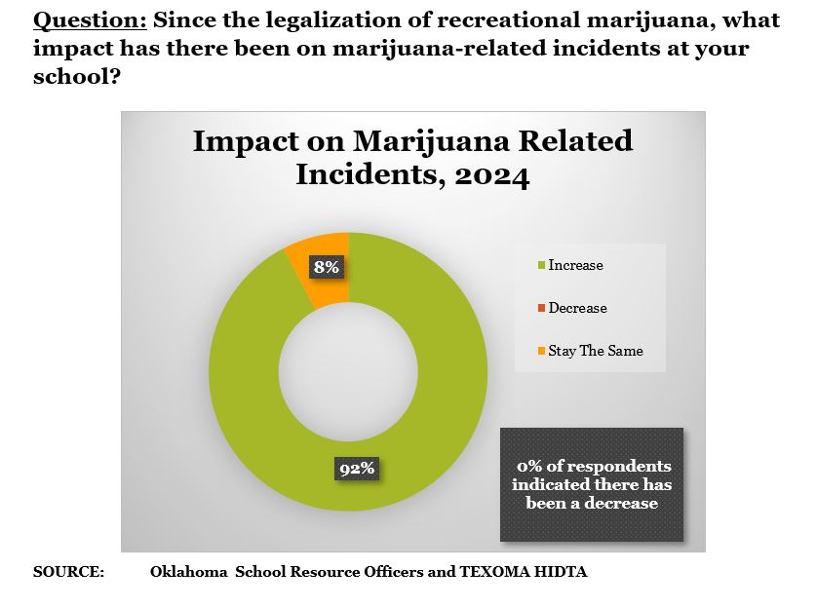
The fifteen states with the lowest rate of current marijuana youth use all have some of the most restrictive marijuana laws in the country. Of those, Utah, Alabama, North Dakota, South Dakota, and Mississippi also have a restrictive form of medical marijuana legalization.
The fifteen states with the highest rate of current marijuana youth use all have full marijuana legalization to include recreational use, aside from Oklahoma and Hawaii which are only legalized medically.

Slide 10
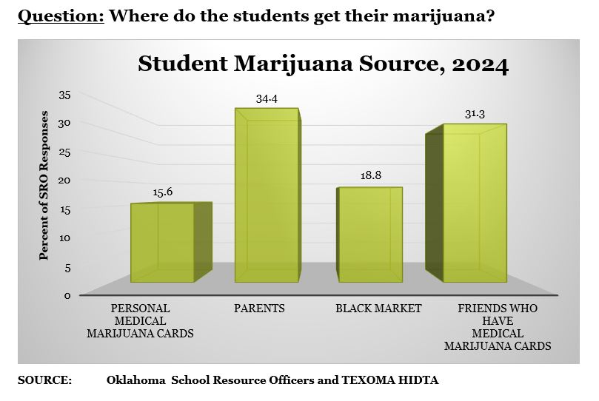

Slide 11
Adult Marijuana Use
College age past month marijuana use increased 53% in the four-year average (2019-2022) since Oklahoma legalized medical marijuana.
Since marijuana was legalized for medicinal use in 2018, college age (18-25 years old) use increased 55%.
The latest 2021/2022 national survey results show Oklahoma adults ranked #11 in the nation for past-month marijuana use, up from #42 in 2017/2018.
Since marijuana was legalized for medicinal use in 2018, use for adults ages 26 and older increased 188%.

Slide 14
Marijuana Investigations
There was a 4,166% increase in pounds of marijuana seized through investigative efforts from 2018 to 2023.
The number of marijuana plants seized through investigative efforts increased 69,573% from 2018 to 2023.
There was a 717% increase in pounds of marijuana seized during interdiction stops from 2018 to 2023.

Slide 15
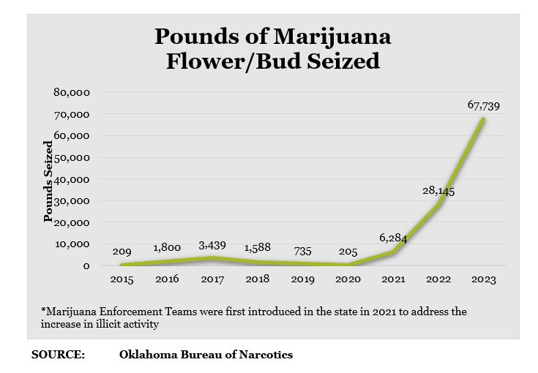

Slide 16
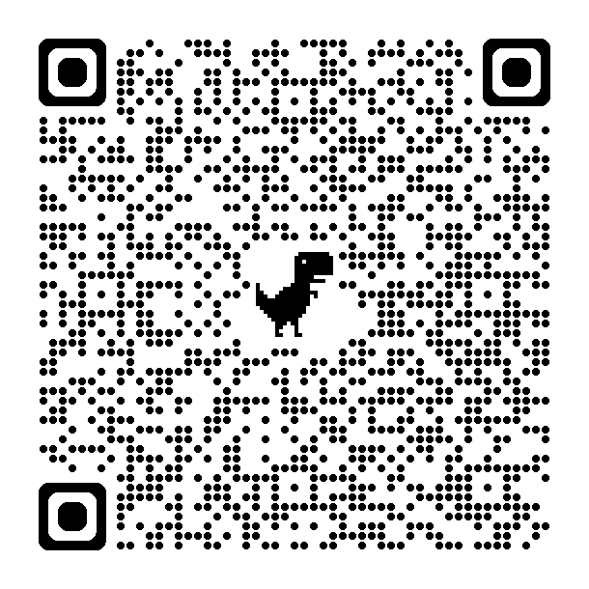
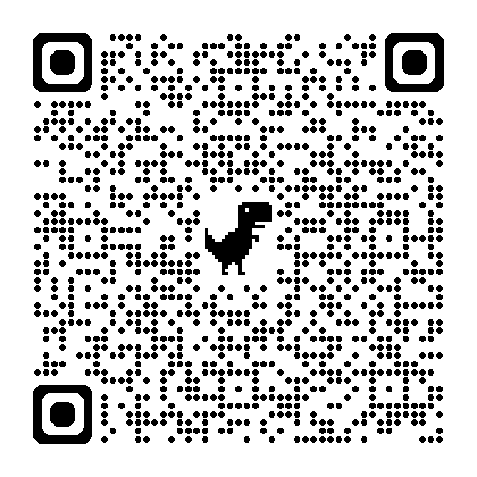
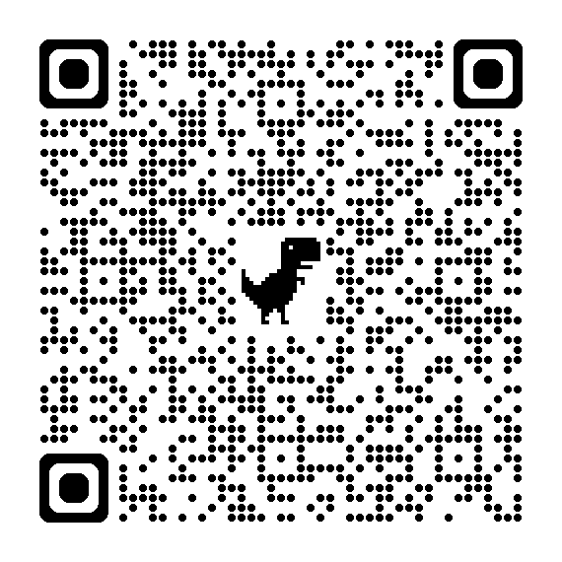
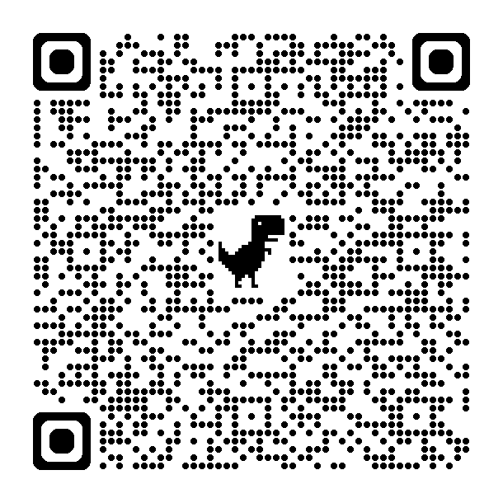
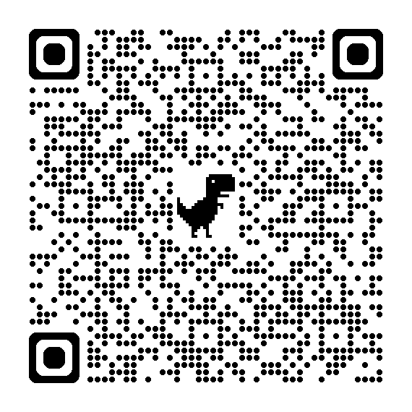

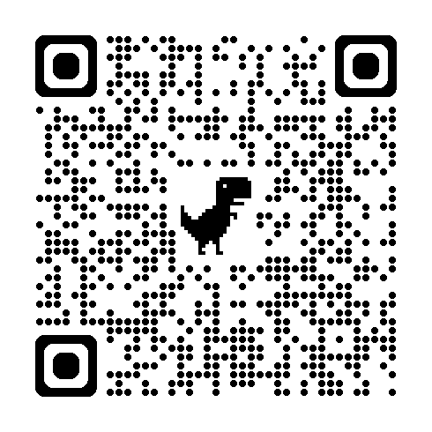
Open-Source Articles Related to Chinese Grow Operations in Oklahoma
Mayhem on the Prairie: Chinese gangsters rule the illicit marijuana trade in Oklahoma
Alleged 'straw ownership' of Oklahoma marijuana operations leads to indictments
From Fujian to Oklahoma: How Chinese mafias are running America’s illegal weed market
A Marijuana Boom Led Her to Oklahoma. Then Anti-Drug Agents Seized Her Money and Raided Her Home
Oklahoma drug agents fighting back against Chinese organized crime linked to illegal marijuana industry
How Chinese organized crime is dominating Oklahoma’s illegal medical marijuana market
Federal Jury Convicts Chinese Nationals of Drug Conspiracy for Illegally Trafficking Black-Market Marijuana from Oklahoma Grow Operation

Slide 17
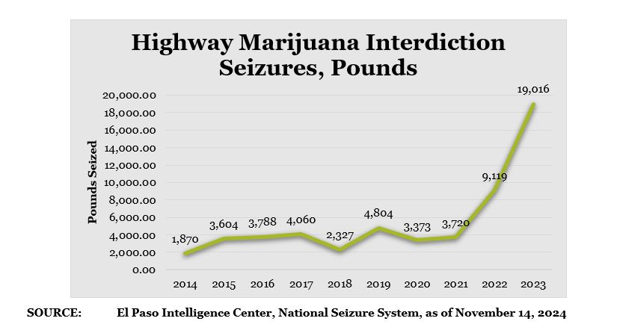

Slide 18
Marijuana Related Emergency Department and Hospital Discharges
The number of youth ages 1-4 discharges for inpatient hospitalizations with nonfatal cannabis poisonings increased 960% from 2016 to 2023.
The number of youth ages 5-14 discharges for inpatient hospitalizations with nonfatal cannabis poisonings increased 300% from 2016 to 2023.
Overall number of discharges for inpatient hospitalizations for all ages with nonfatal cannabis poisonings increased 228% from 2018 to 2023.

Slide 19
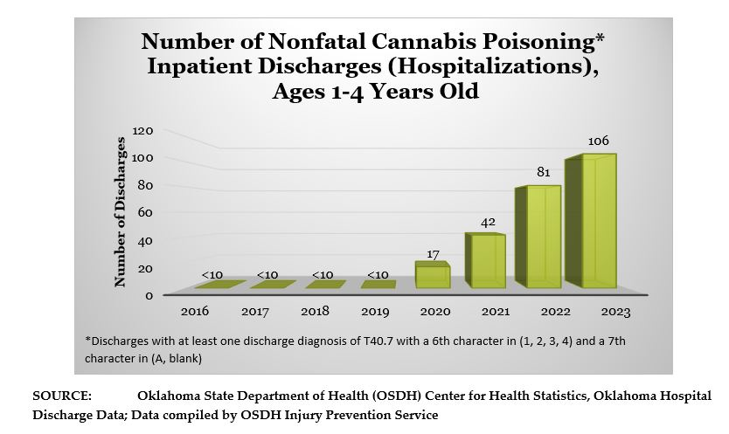

Slide 20
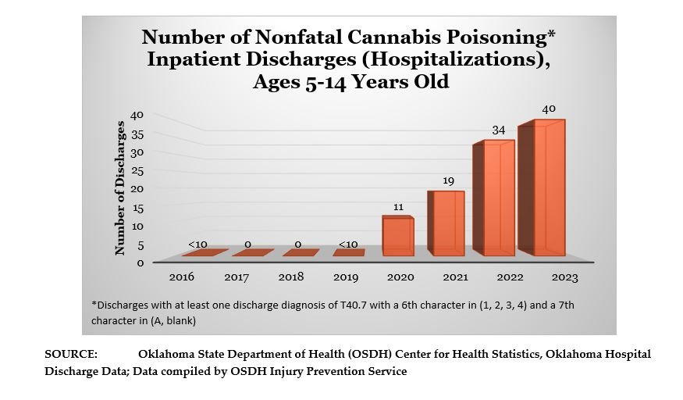

Slide 21
Marijuana poison control calls increased significantly for each age group comparing the five-year average (2019-2023) since Oklahoma legalized medical marijuana to the five-year average (2014-2018) prior to legalization. 2,529% increase Ages 0-5 Years Old 381% increase Ages 6-19 Years Old 338% increase Ages 20+ Years Old
Marijuana Poison Control Calls

Slide 22
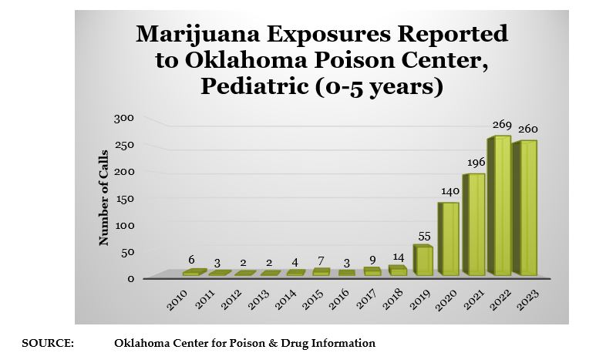

Slide 23
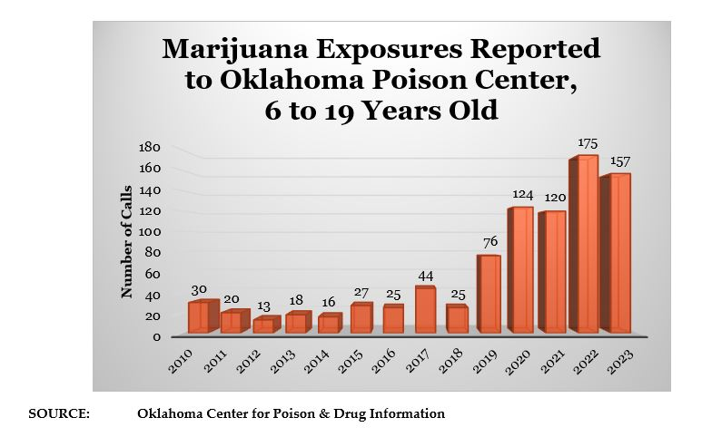

Slide 24
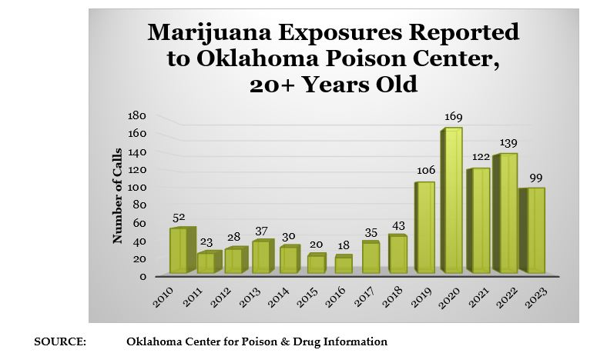

Slide 25
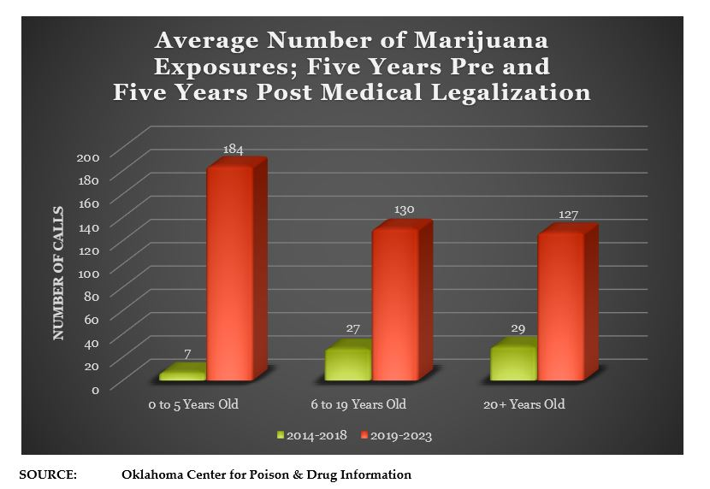

Slide 26
Treatment Admissions
According to the Oklahoma Department of Health, approximately 1 in 10 people who use marijuana will become addicted. This statistic is further exacerbated when an individual begins marijuana use before the age of 18. At that point the rate of addiction rises to 1 in 6.

Slide 27
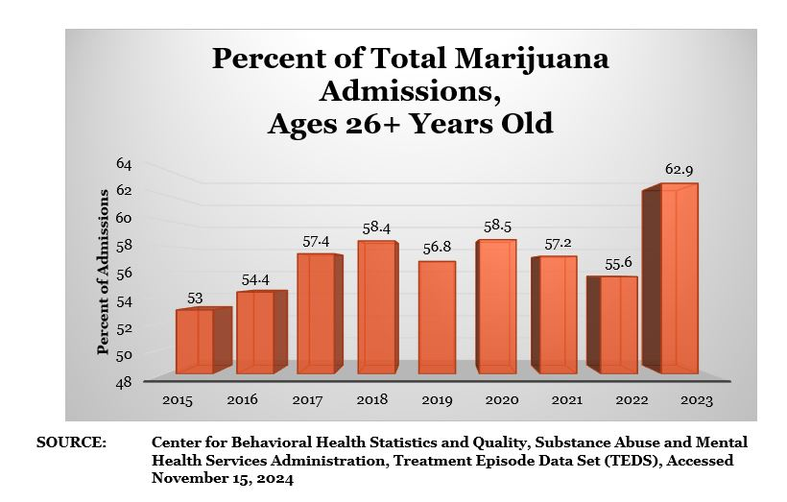

Slide 28
Impaired Driving
There was a 327% increase in the number of cases testing positive for Cannabinoids from 2019 to 2023
In 2023, Cannabinoids were the top drug detected in traffic death investigations.
From 2020-2023, Cannabinoids were the most common drug found in cases submitted for testing (In 2019, cannabinoids were the 3rd most common drug submitted for testing)

Slide 29
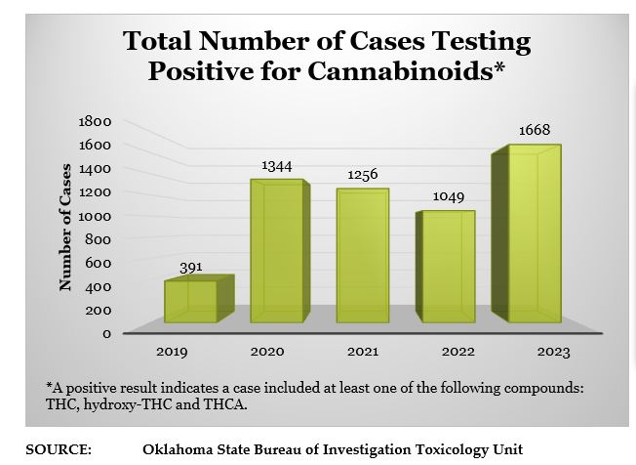

Slide 30
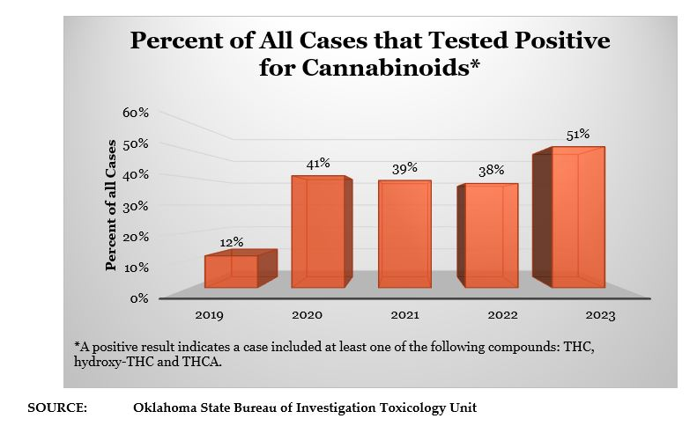

Slide 31
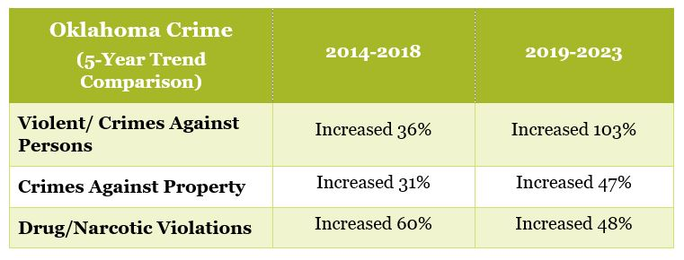
Increase in Crime

Slide 32
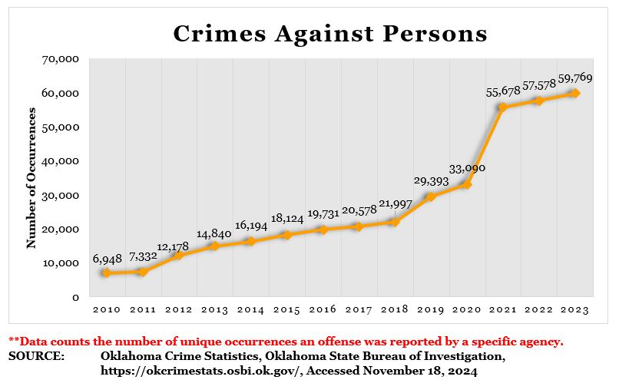

Slide 33
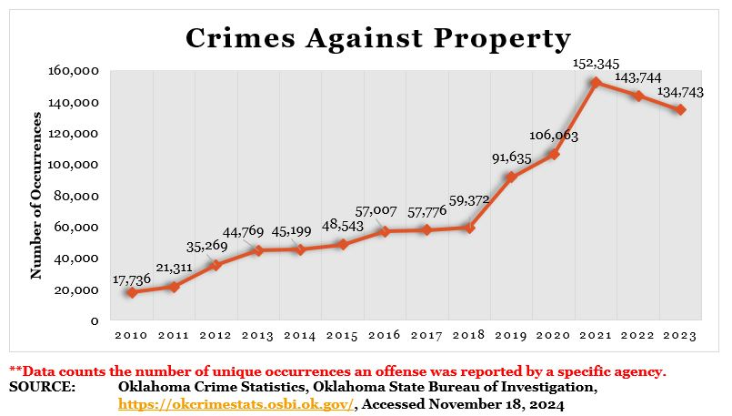

Slide 34
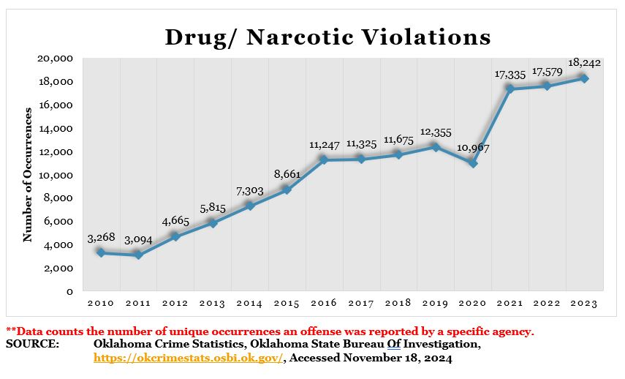

Slide 35
Public Safety Regarding Grow Operations
There have been numerous public safety dangers and hazards related to marijuana grow and manufacture operations. As a result, the Oklahoma Bureau of Narcotics (OBN) has begun enforcing the requirement for any business to obtain a certificate of occupancy/final inspection (CO) before being granted a new registration or renewing an existing one (the same burden on marijuana businesses that are placed on all other public businesses).

Slide 36
Examples
“Since 2021, there have been at least 10 confirmed fires at marijuana manufacturer locations. In one of the fires, two employees were severely burned and sent to the hospital. This fire also resulted in first-degree felony arson charges being filed.”
“In another fire, more than 10,000 acres of land were set ablaze after medical marijuana combusted. This fire required the activation of the National Guard and numerous agencies from all over Oklahoma and Texas.”
“OBN agents have also seen evidence of previous fires on numerous occasions at marijuana manufacturing locations. In fact, on two separate enforcement operations, OBN agents were present when fires ignited in grow rooms.”
SOURCE: “Oklahoma Bureau of Narcotics and Dangerous Drugs Control Position Statement on Medical Marijuana Registrants Providing Certificates of Occupancy”, July 2023, Oklahoma Bureau of Narcotics, https://www.obndd.ok.gov/home/showpublisheddocument/430/638252794456800000

Slide 37
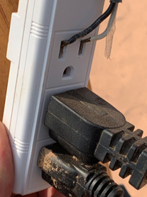
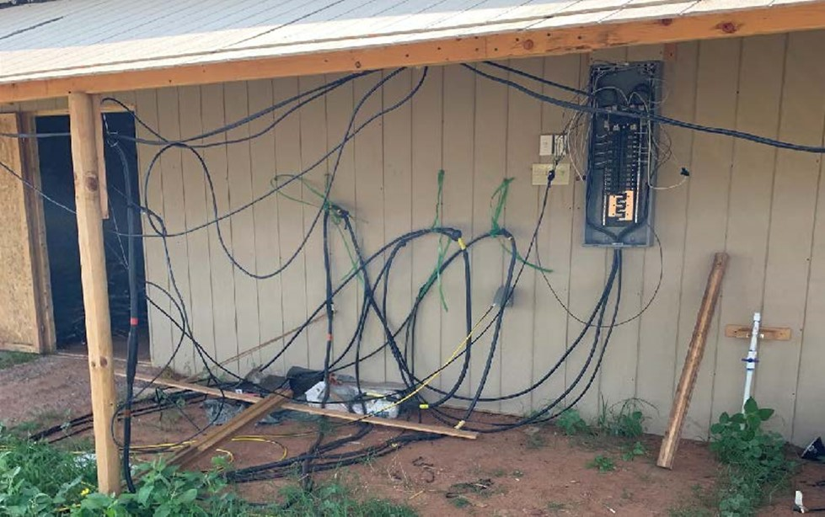

Slide 38
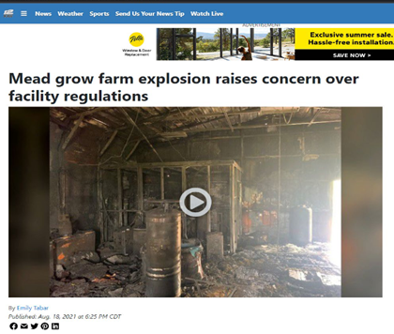
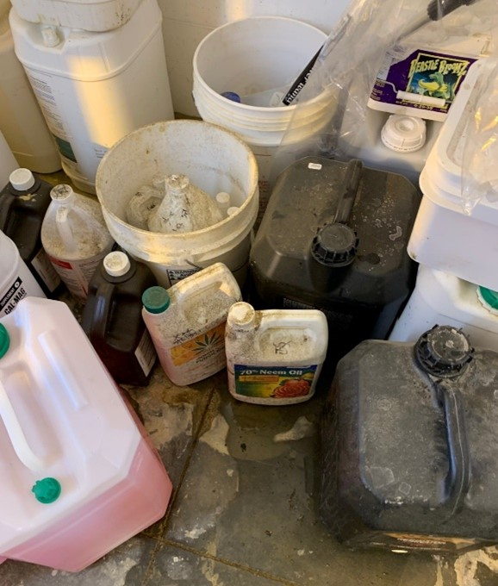
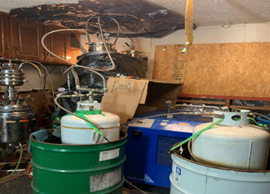

Slide 39
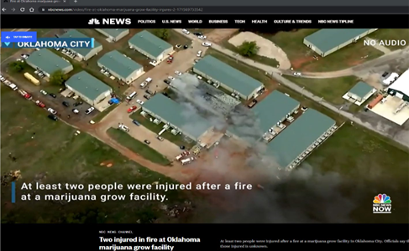
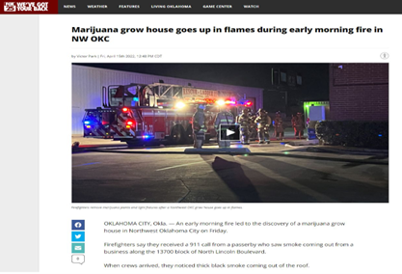

Slide 40
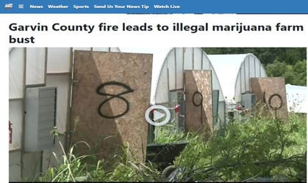

Slide 41
Contact Information
Name, Title
Unit
Oklahoma Bureau of Narcotics and Dangerous Drugs
(405) Phone or (800) 522-8031
Email address
https://www.ok.gov/obndd/

